Slide 1
PowerShell Datacenter Utilities
Adam Driscoll

Slide 2
Agenda
Remoting
Web Services
Desired State Configuration
Lab

Slide 3
Remoting
Available since PowerShell v2
Can execute commands against one to many remote machines
Supports resilient and persistent sessions
Uses the WinRM protocol
Can now remote into Hyper-V machines via PowerShell Direct
Get-Help about_Remoting

Slide 4
Enabling remoting
Enable-PSRemoting
On by default on Window Server 2012 R2 and up
By default, requires CredSSP authentication but can be configured to use certificates or Kerberos
Additional configuration can be done using the WinRM utilities
Get-Help about_Remoting

Slide 5
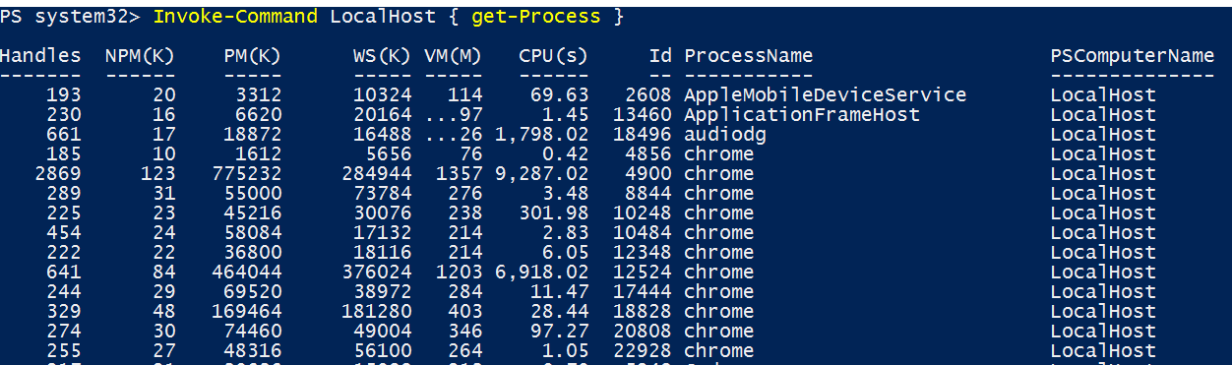
Non-Interactive Remoting
Invoke-Command –ComputerName
Enables fan-out scenarios

Slide 6
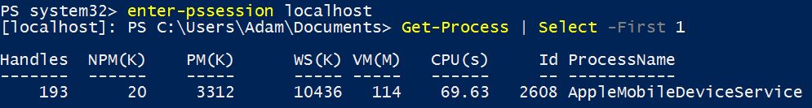
Interactive Remoting
Enter a session on a remote machine and issue commands as if you were local
Enter-PSSession to enter the session
Exit-PSSession to exit the session

Slide 7
Remoting Endpoints
Configurable to expose on certain commands
Can impersonate users
Two default endpoints – x86\x64
Can execute scripts on start up

Slide 8
Web Services
Consume popular web technologies via PowerShell
Automatically convert JSON to PSObjects
Automatically can create proxy objects based on SOAP web services

Slide 9
Web Service Cmdlets
Invoke-WebRequest – Calls an HTTP method and returns the result as an HTTP response
Invoke-RestMethod – Calls an HTTP REST method and returns the result as a deserialized JSON object.
New-WebServiceProxy – Creates a SOAP proxy object based on a WSDL for use against the API.

Slide 10
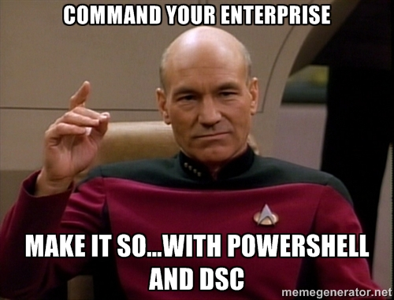
Desired State Configuration
Introduced in PowerShell v4.0
Configure systems through idempotent, domain specific language
Separate configuration from logic
Executes in push or a pull model

Slide 11
DSC Concepts
Configurations – PowerShell script that defines resources to be applied to target system.
Resources – Imperative building blocks of DSC configurations. Examples include File, VirtualMachine, Website
Local Configuration Manager – Service that executes configurations on the local node.

Slide 12
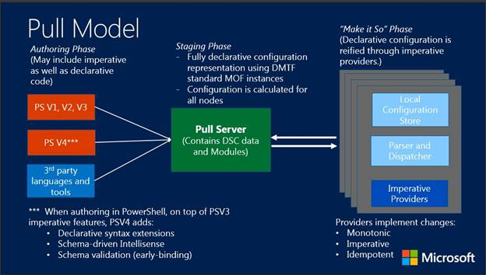

Slide 13
Creating your own resources
Script and MOF based resources
Class-based resources

Slide 14
DSC Resource Naming Convetions
X – Experimental
C – Community
xWebAdministration
xSQLServer
xJea
PolicyFileEditor
cWindowsOS
cWMIPermanentEvents

Slide 15
Lab
Enable remoting on your local machine and use it to enter an interactive session and invoke commands.
Get the title of the last 10 commits on the VS Code GitHub repository.
Create a DSC resource to configure remoting
Add configurable options to the class
Ensure it can both enable\disable remoting

